Slide 1
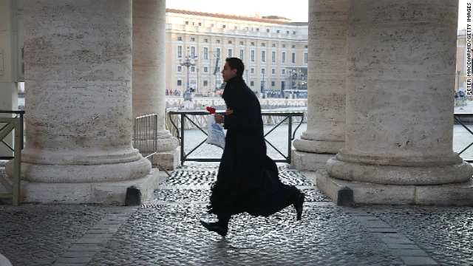

The key to success at SVDP
Time Management tips
Prof. Antonio Balsón

Slide 2

Time management is a myth
There are 24 hours in a day
You should be sleeping at least 7 of them
Praying
Exercising
Eating (well)
Socializing
Oh, and…..
Studying

Slide 3

Key #1 to success:
What is your goal?
Long term >5 years? (Maybe ordination)
Medium term +/- 2 years?
Short term 1 year?
Write them down!!!!

Slide 4
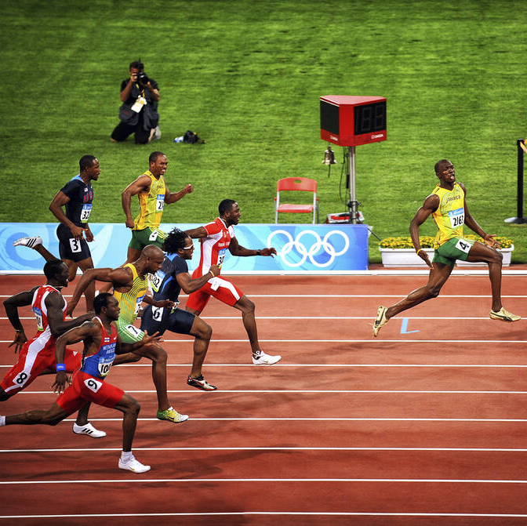
What do you need to do to achieve goals?
Be prepared
Study / read / write
Research
Participate
Build relationships
Be punctual
Be presentable

Slide 5
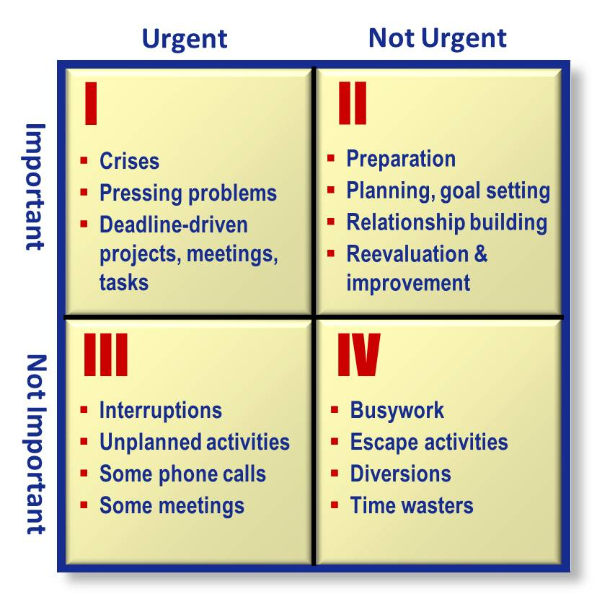
Priorities vs Time thieves

Slide 6
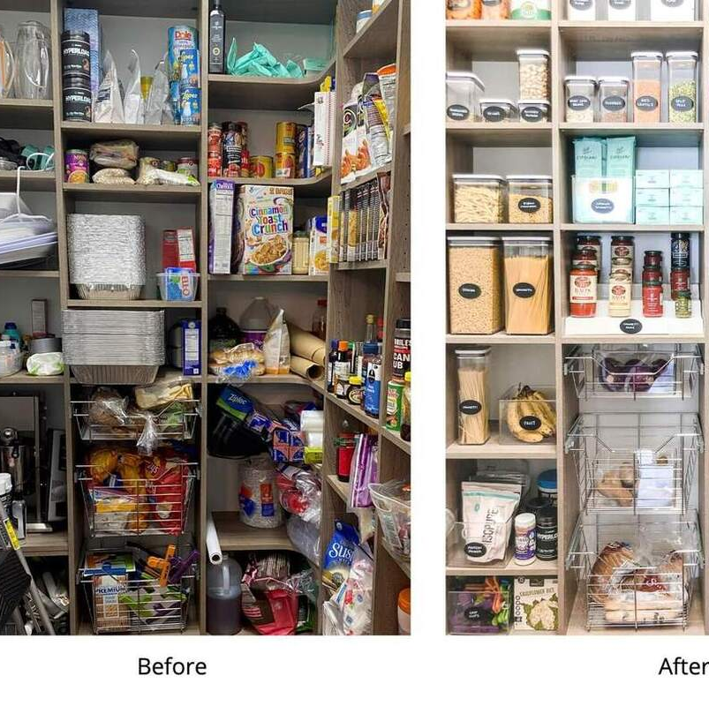
How???
Organize, organize, organize
Plan ( review tasks the night before)
Finish each task
Learn how to say no
Simplify
Develop systems
Develop routines
WRITE IT DOWN
Calendar

Slide 7
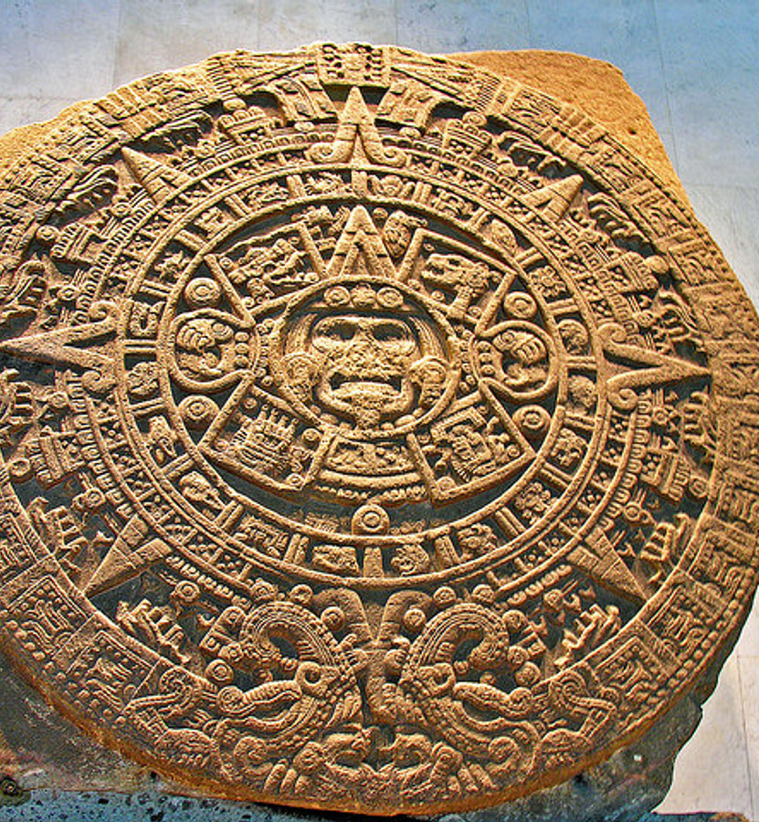
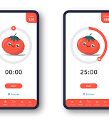

Use all possible resources (and leverage them)
Calendar
Pomodoro app.
Alarm clock

Slide 8
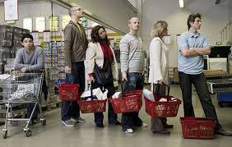

Don’t waste time waiting
In a waiting room? Bring a book
In line at the supermarket? Spanish flash cards ☺
Hands free system in your car? Call family and friends

Slide 9
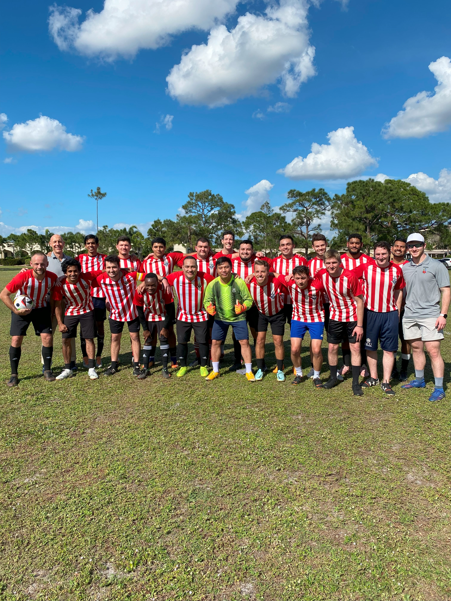
Conclusion
Set Goals AND write them down
Plan your time
Know your time thieves and manage them
Write down everything you have to do
Organize
Prioritize
Have fun
Sleep

